Slide 1


Predicting Loan Application Status
By Johnathan Jack

Slide 2


Overview
Hypothesis
Exploratory Data Analysis
Results
Challenges
Future Goals

Slide 3
Hypothesis
1. Applicants with a higher combined income will have a higher chance of obtaining a loan
2. Credit history will also impact this decision even if their income are the same

Slide 4

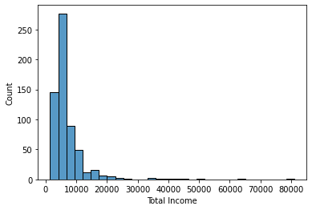
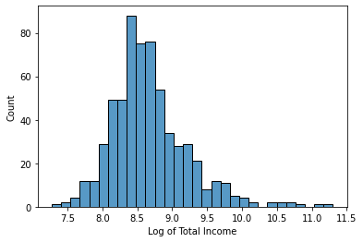
Distribution of Income
Combined both Applicant and Co-applicant income
Extreme Outliers present
Performed log transformation for better results

Slide 5
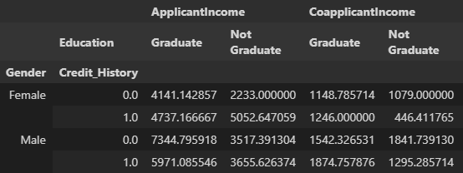
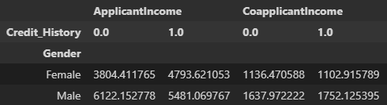
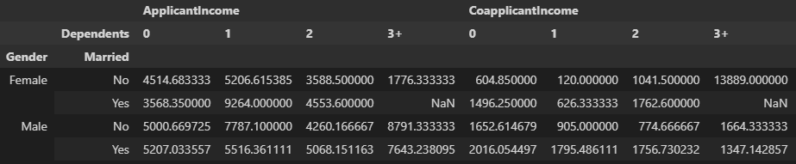
Pivot Tables
Graduates tend to have a higher overall income except for co-applicant males with no credit history being the only one lower
Males on average have higher income than females
Female applicants that have one dependent have a higher income
Male applicants that have 3+ dependents have a higher income

Slide 6
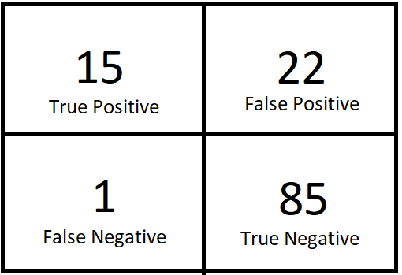
Results
Model: Random Forest Classifier
Accuracy: 81%
Precision: 41%
Negative Prediction: 98%
Model is poor for approving loans but excellent in declining loan!

Slide 7
Challenges/Future Goals
Not many features that could be engineered with the data
There was a very high bias for males, marital status, education, credit history and employment type leading to model bias for these features
Model is poor at predictions where applicants have no credit history
If applicants have credit history, if they have a log of combined total income > 8, it is always approved

